Slide 1
The Android Software Stack
Android stack has five layers:
Linux Kernel
Libraries
Application Framework
Applications
Android Runtime

Slide 2
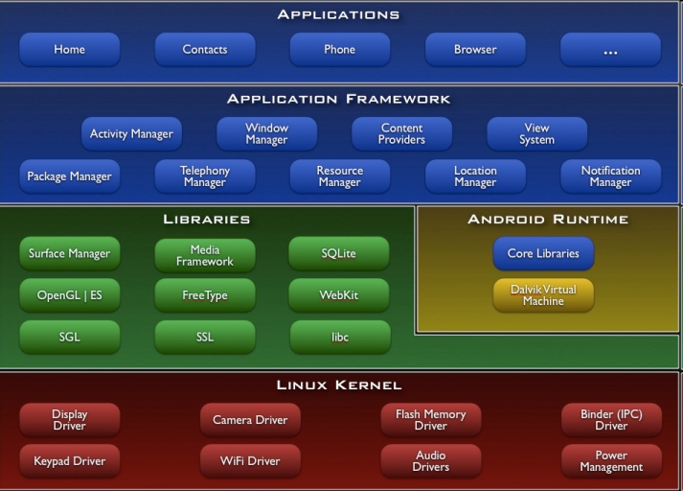
The Android Software Stack

Slide 3

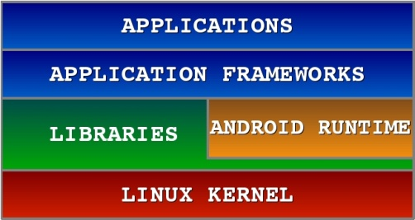
Android S/W Stack - Application
Android provides a set of core applications:
Email Client
SMS Program
Calendar
Maps
Browser
Contacts

Slide 4
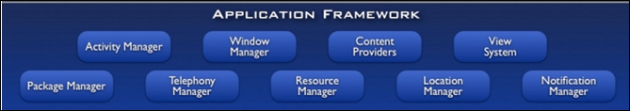
Android S/W Stack – Application Framework
On the top of Native libraries and android runtime, there is android framework.
Android framework includes Android API's such as UI (User Interface), telephony, resources, locations, Content Providers (data) and package managers.
It provides a lot of classes and interfaces for android application development.

Slide 5
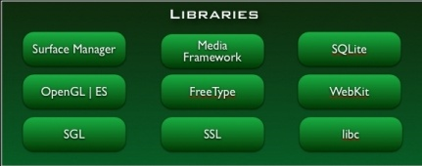
Android S/W Stack - Libraries
On the top of linux kernel, their are Native libraries such as WebKit, OpenGL, FreeType, SQLite, Media, C runtime library (libc) etc.
The WebKit library is responsible for browser support, SQLite is for database, FreeType for font support, Media for playing and recording audio and video formats.

Slide 6
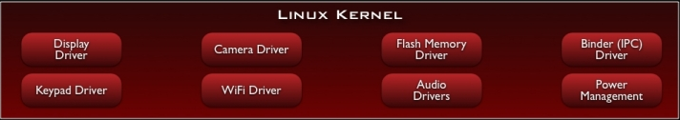
Android S/W Stack – Linux Kernel
It is the heart of android architecture that exists at the root of android architecture.
Linux kernel is responsible for device drivers, power management, memory management, device management and resource access.
The supplied device drivers include Display, Camera, Keypad, WiFi, Flash Memory, Audio, and IPC
Providing an abstraction layer between the H/W and the rest of the S/W stack

Slide 7
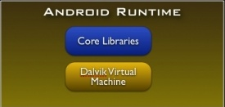
Android S/W Stack - Runtime
Core Libraries
Providing most of the functionality available in the core libraries of the Java language
APIs
Data Structures
Utilities
File Access
Network Access
Graphics, etc

Slide 8
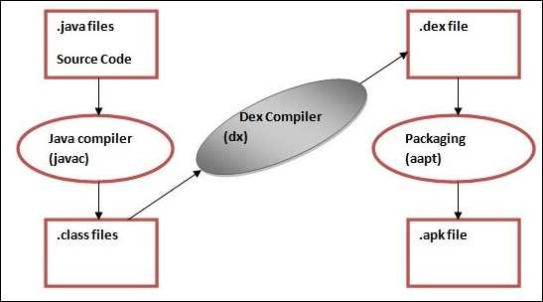
Android S/W Stack – Runtime (Cont)
The Dalvik Virtual Machine (DVM) is an android virtual machine optimized for mobile devices.
It optimizes the virtual machine for memory, batterylife and performance.
The Dex compiler converts the class files into the .dex file that run on the Dalvik VM. Multiple class files are converted into one dex file.

Slide 9
Android S/W Stack – Runtime (Cont)
The javac tool compiles the java source file into the class file.
The dx tool takes all the class files of your application and generates a single .dex file. It is a platform-specific tool.
The Android Assets Packaging Tool (aapt) handles the packaging process.

Slide 10
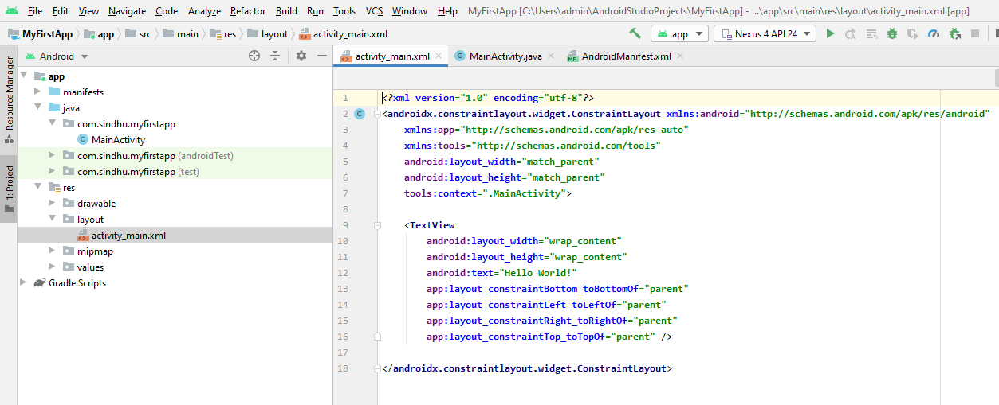
App Fundamentals
The activity_main.xml is a layout file available in res/layout directory, that is referenced by your application when building its interface. You will modify this file very frequently to change the layout of your application.

Slide 11
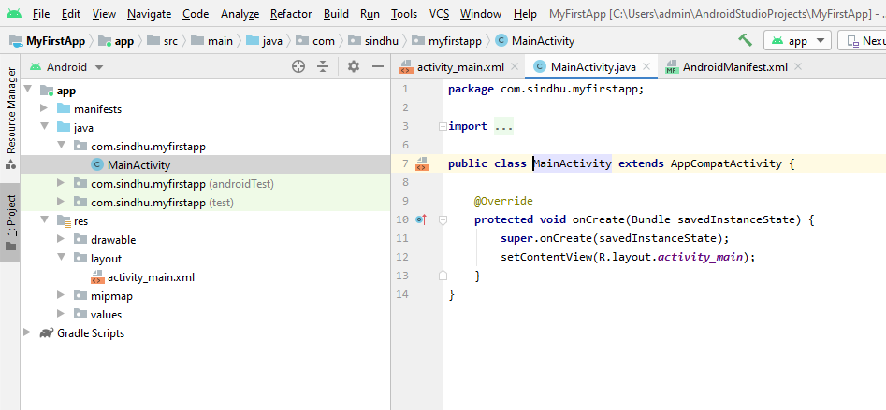
App Fundamentals
The main activity code is a Java file MainActivity.java. This is the actual application file which ultimately gets converted to a Dalvik executable and runs your application.

Slide 12
App Manifest
The AndroidManifest.xml file contains information of your package, including components of the application such as activities, services, broadcast receivers, content providers etc.
It is responsible to protect the application to access any protected parts by providing the permissions.
It also declares the android api that the application is going to use.
This is the required xml file for all the android application and located inside the root directory.

Slide 13
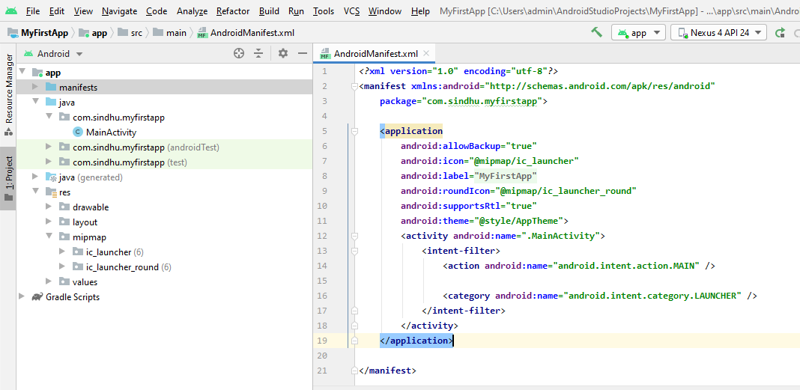
AndroidManifest.xml

Slide 14
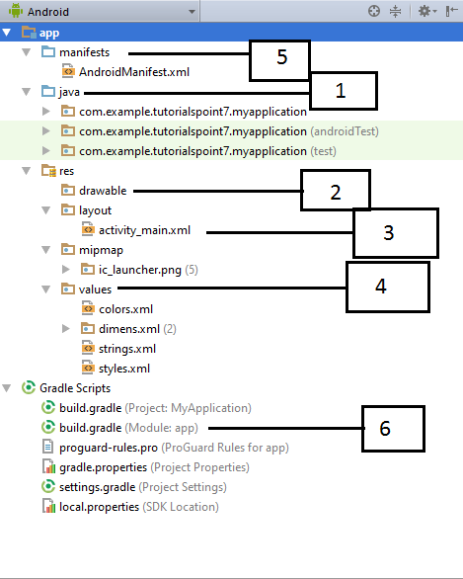
Structure of Android Application
Before we run our app,
we should be aware of a
few directories and files
in the Android project.
Each project module appears
as a folder at the top level
of the project hierarchy
and contains these three
elements at the top level:
java/ :
Source files for the module.
manifests/ :
Manifest files for the module
res/ :
Resource files for the module
Notes:
https://www.tutorialspoint.com/android/android_hello_world_example.htm

Slide 15
Structure of Android Application
Sl.No. | Folder, File & Description
1 | Java: This contains the .java source files for your project. By default, it includes an MainActivity.java source file having an activity class that runs when your app is launched using the app icon.
2 | res/drawable-hdpi: This is a directory for drawable objects that are designed for high-density screens.
3 | res/layout: This is a directory for files that define your app's user interface.
4 | res/values: This is a directory for other various XML files that contain a collection of resources, such as strings and colours definitions.
5 | AndroidManifest.xml: This is the manifest file which describes the fundamental characteristics of the app and defines each of its components.
6 | Build.gradle: This is an auto generated file which contains compileSdkVersion, buildToolsVersion, applicationId, minSdkVersion, targetSdkVersion, versionCode and versionName

Slide 16
What is activity_main.xml in android?
It has information about layout in an application
What is MainActivity.java in android?
It has the information about activities in an application

Slide 17
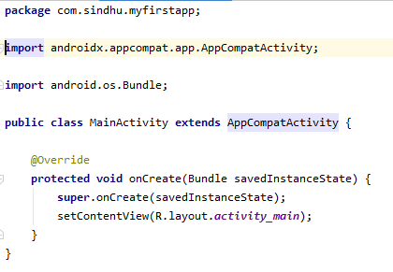
What is Activity?
An activity represents a single screen with a user interface. For example, an email application might have one activity that shows a list of new emails, another activity to compose an email, and one for reading emails. If an application has more than one activity, then one of them should be marked as the activity that is presented when the application is launched.For example, MainActivity class is subclassing a super class called as a AppCompatActivity

Slide 18
R.java
Android R.java is an auto-generated file by aapt (Android Asset Packaging Tool) that contains resource IDs for all the resources of res/ directory.
If you create any component in the activity_main.xml file, id for the corresponding component is automatically created in this file.
This id can be used in the activity source file to perform any action on the component.

Slide 19
Android Core Building Blocks
The core building blocks or fundamental components of android are :
Activities
Views
Intents
Services
Content providers
Fragments

Slide 20
Android Core Building Blocks
Activity : An activity is a class that represents a single screen.
View : A view is the UI element such as button, label, text field etc. Anything that you see is a view.
Intent : Intent is used to invoke components. It is mainly used to:
Start the service
Launch an activity
Display a web page
Display a list of contacts
Broadcast a message
Dial a phone call etc.

Slide 21
Android Core Building Blocks
Service : Service is a background process that can run for a long time. There are two types of services local and remote.
Local service is accessed from within the application Remote service is accessed remotely from other applications running on the same device.
Content Provider : Content Providers are used to share data between the applications.
Fragment : Fragments are like parts of activity. An activity can display one or more fragments on the screen at the same time.

Slide 22
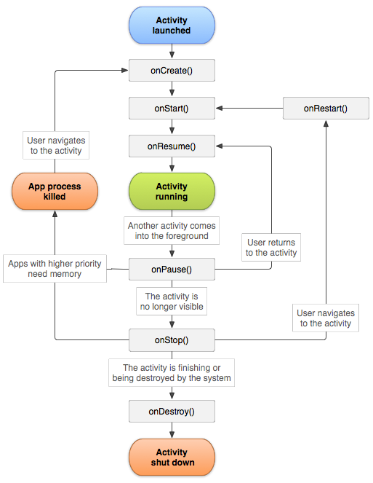
Activity Lifecycle

Slide 23
Activity Lifecycle
When you run your android application, Activity goes through different states and the following callback methods are called by system.
onCreate(): Called when the activity is first created. You can write the code for initializing the control/view.
onStart(): This method is called when the activity becomes visible to the user.
onResume(): It is called when the activity starts interacting with the user.
onPause(): It is called when the current activity is being paused and the previous activity is being resumed. Activity is not destroyed, but it is invisible.
onStop(): It is called when the activity is stopped and not visible to the user.
onDestroy(): It is called before the activity is destroyed by the system call.
onRestart(): It is called when the activity has been stopped and is restarting again.

Slide 24
Android Toast
Android Toast can be used to display information for the short period of time.
A toast contains message to be displayed quickly and disappears after sometime.
The android.widget.Toast class is the subclass of java.lang.Object class.
Toast.makeText(getApplicationContext(),”Mesage",Toast.LENGTH_SHORT).show();

Slide 25
Program 1
Create an application with the following :
A. When you run the code, and when the application starts the three toast messages are to be displayed that come after one another. First is ON CREATE , second is ON START and third is ON RESUME.
B. When you press the home button from the emulator, ON PAUSE and ON STOP methods are to be called.
C. When you open the application again ON RESTART, ON START and ON RESUME methods are to be called.
D. when you press the back button from emulator, ON PAUSE , ON STOP and ON DESTROY method are to be called..

Slide 26
package com.sindhu.prg1androidlifecycle; import androidx.appcompat.app.AppCompatActivity; import android.os.Bundle; import android.widget.Toast; public class MainActivity extends AppCompatActivity { @Override protected void onCreate (Bundle savedInstanceState) { super.onCreate (savedInstanceState); setContentView (R.layout.activity_main); Toast.makeText (this,"ON CREATE", Toast.LENGTH_SHORT).show(); } @Override protected void onStart() { super.onStart(); Toast.makeText (this,"ON START", Toast.LENGTH_SHORT).show(); }

Slide 27
@Override protected void onResume() { super.onResume(); Toast.makeText (this,"ON RESUME", Toast.LENGTH_SHORT).show(); } @Override protected void onPause() { super.onPause(); Toast.makeText (this,"ON PAUSE", Toast.LENGTH_SHORT).show(); } @Override protected void onRestart() { super.onRestart(); Toast.makeText (this,"ON RESTART", Toast.LENGTH_SHORT).show(); }

Slide 28
@Override protected void onStop() { super.onStop(); Toast.makeText (this,"ON STOP", Toast.LENGTH_SHORT).show(); } @Override protected void onDestroy() { super.onDestroy(); Toast.makeText (this,"ON DESTROY", Toast.LENGTH_SHORT).show(); } }

